Slide 1


Bank Bankruptcy Prediction. Date: 07/03/2024 By group 5

Slide 2
Team members:
1)Aditya Awad
2)Anuja Sasane
3)Bala Ram
4)Gaurav Choudhari
5)Omini Madhukar Jhadav
6)Suchetha D H

Slide 3
Objectives
Bank bankruptcy prediction involves several variables, each serving a specific purpose in prediction of bank bankruptcy. Here are some variables which helps in prediction:
1)ROA(C) before interest and depreciation before interest.
2)ROA(A) before interest and % after tax.
3)ROA(B) before interest and depreciation after tax.
4)Operating Gross Margin Realized Sales Gross Margin.
5)Liability to Equity.

Slide 4
Libraries Used:
Pandas
Matplotlib
Seaborn
Sklearn
numpy

Slide 5
Project Work involves:
1.Analyze the data
2.Cleaning the data(EDA)
3.Data Visualization and Feature
Engineering
4.Building different models
5.Model Deployment

Slide 6
Exploratory Data Analysis (EDA) is a crucial step in predicting bank bankruptcy prediction as it helps understand the underlying patterns, trends, and relationships within the data.
1. Analyse the data: Calculate summary statistics such as mean, median, standard deviation, minimum, maximum, and quartiles to understand the central tendency, variability, and distribution of data.
2. Cleaning data: Looking for null and duplicated values in data, if found the null and duplicated values are treated and looking for outliers in the data and id found are treated to get the cleaned data and Correlation Analysis: Examine the correlation between different relevant variables such as: Use correlation matrices, scatter plots, or heat maps to visualize and quantify the relationships and feature engineering is also done to get best 30 features for better model building.

Slide 7
3.Data Visualization: Examine the distribution of different variables to assess their normality or identify potential skewness and kurtosis. Use histograms, pie chart to visualize the distribution and compare it with theoretical distributions like the normal distribution.
4.Building different model: Based on insights gained from EDA, identify potential models or forecasting techniques that are suitable for modeling Bank bankruptcy prediction. Consider factors such as distribution of data and the relationship with relevant variables.
5.Model Deployment: Deployment of suitable model which gives best accuracy for unseen data prediction is done using and the model gets deployed.

Slide 8
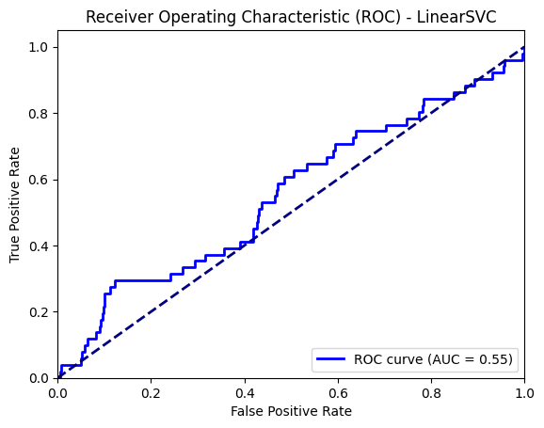
Data Visualization by SVM(Linear Kernel):

Slide 9
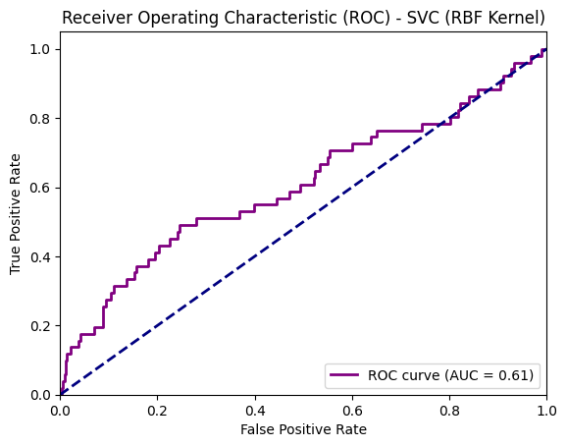
Data Visualization by SVM(RBF Kernel):

Slide 10
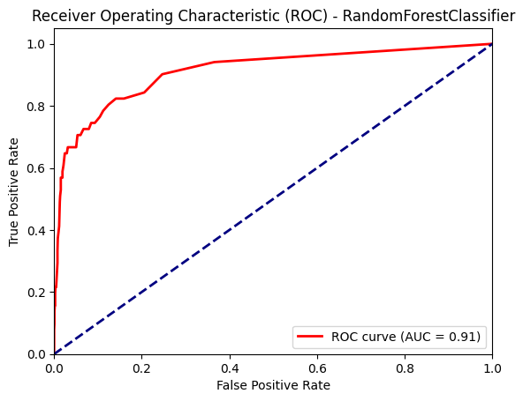
Data Visualization by Random Forest:

Slide 11
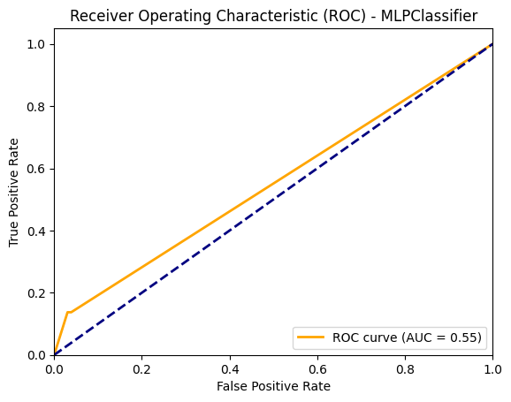
Data Visualization by Neural Network:

Slide 12
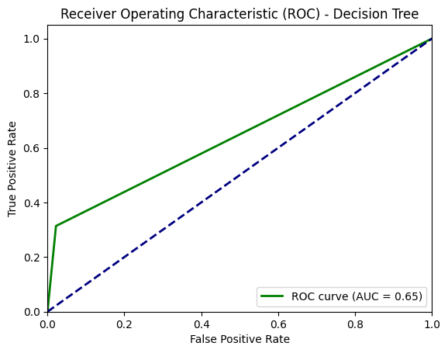
Data Visualization by Decision Tree:

Slide 13
Data Visualization by Logistic Regression:

Slide 14
Models used in Prediction of Bank Bankruptcy.
Logistic Regression
Decision Tree
Random Forest
Neural Network
SVM

Slide 15
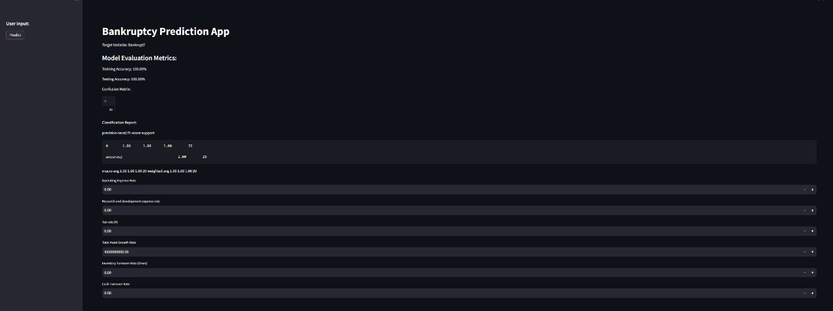
Model Deployment Screenshots
.

Slide 16
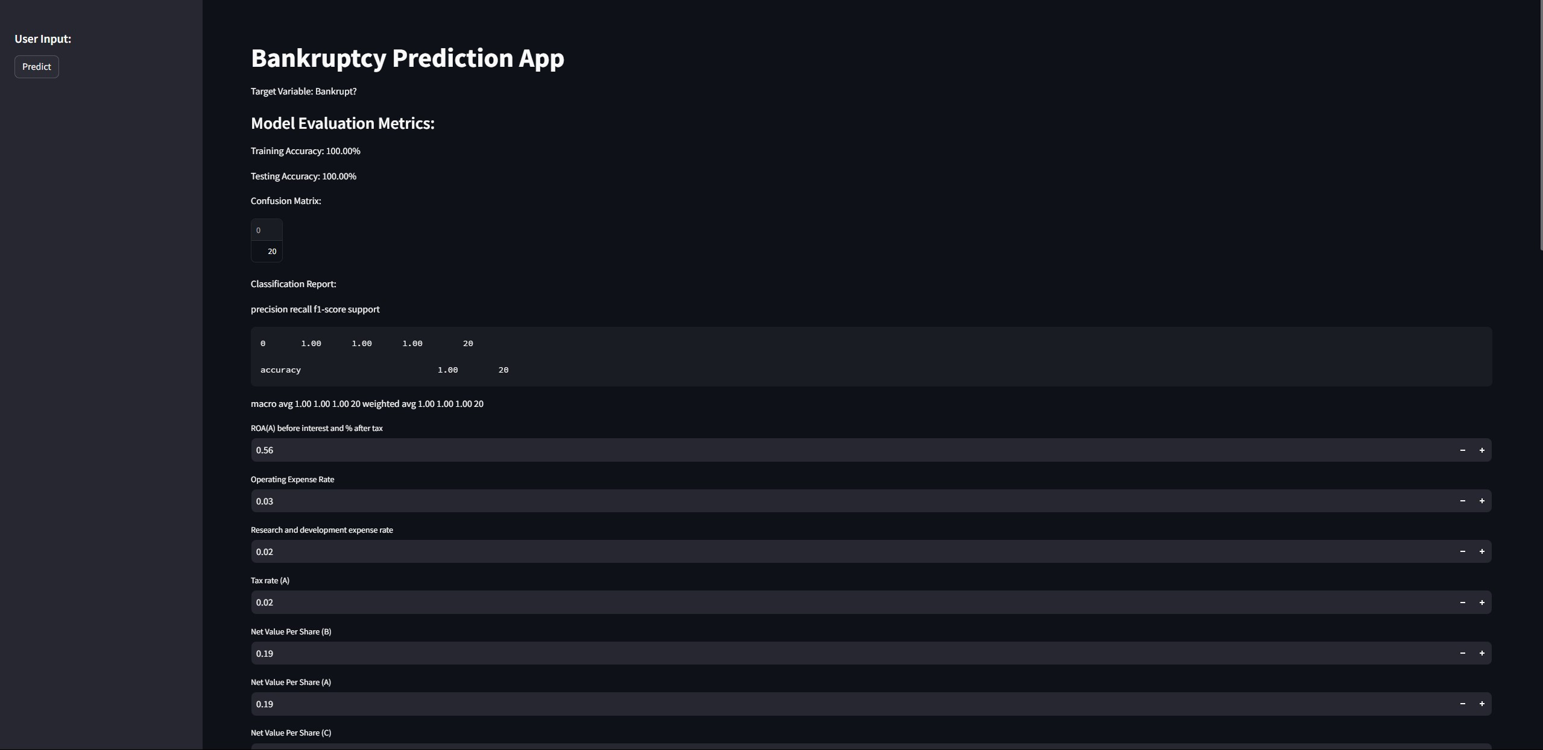

Slide 17
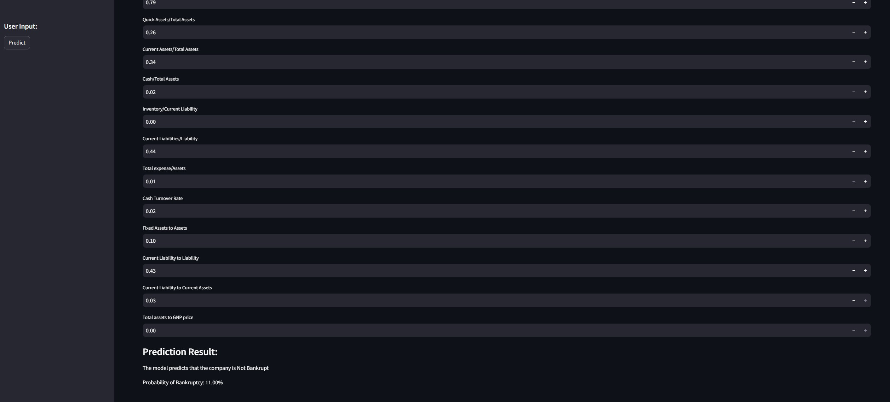

Slide 18
Challenge we faced while working on this project
There were 95 Variables which are affecting the independent variable.
We found difficulty in feature selection too.
The training and testing accuracy for different models tried out were very similar values so analyzed thoroughly to select best model for deployment.

Slide 19
Overcoming the Challenges:
1) We overcame these challenges by analyzing correlation matrix.
2) Done coding to get best possible features for better model building.
3) Best model for deployment is finalized after thorough discussion.

Slide 20


